Slide 1
C Programming
Command Line Arguments

Slide 2
So Far ...
int main(void)

Slide 3
But we can also do …
int main(int argc, char *argv[])

Slide 4
Eh?
We can get additional arguments from the command line.
The use of the names argc and argv are traditional.

Slide 5
Possible Examples
dir c:\
edit fred.txt
copy fred.txt barney.txt
assign5 fred.txt barney.txt wilma.txt
assign5 “fred and barney.txt” wilma.txt

Slide 6
Command Line Arguments
Command line arguments provide information to the command that you’re running.
This is done through the argc and argv method.

Slide 7
int argc
argc contains the number of command line arguments (words or double-quoted strings after the command name)
... almost ...

Slide 8
The command name is included as one of them

Slide 9
Argc is at least 1

Slide 10
argc for the Examples
dir c:\
argc is 2
edit fred.txt
argc is 2
copy fred.txt barney.txt
argc is 3
assign5 fred.txt barney.txt wilma.txt
argc is 4
assign5 “fred and barney.txt” wilma.txt
argc is 3
the use of the quotation marks make “fred and barney.txt” one argument even though it has spaces in it
dir
argc is 1

Slide 11
char *argv[]
argv contains an array of pointers to strings, where each pointer is an argument.

Slide 12
Double-quoted strings are treated as one argument; otherwise one argument is one word (whitespace-delimited).

Slide 13
The last item in argv is argv[argc], which is a NULL pointer

Slide 14
argv[0] always contains the command name

Slide 15
Example
#include <stdio.h>
int main(int argc, char *argv[])
{
int argNum = 1;
printf("Here's the command line contents:\n");
printf("Command: %s\n", argv[0]);
for( argNum = 1; argNum < argc; argNum++ )
{
printf("Arg #%d: %s\n", argNum, argv[argNum]);
}
return 0;
}

Slide 16
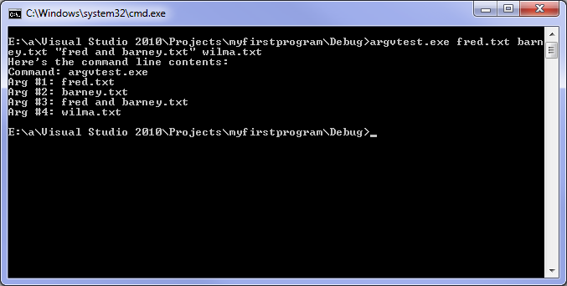

Slide 17
Using Command Line Arguments In The IDE
The easiest way to use command line arguments is to open a Command Window and type the command name.

Slide 18
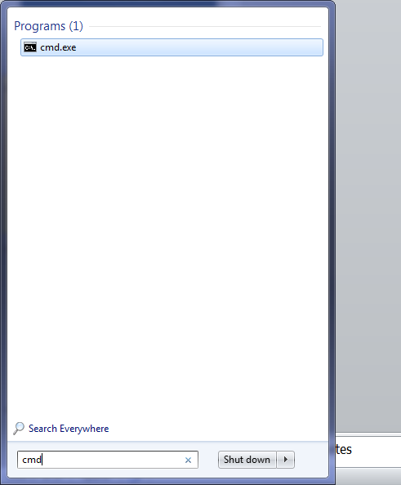

Slide 19
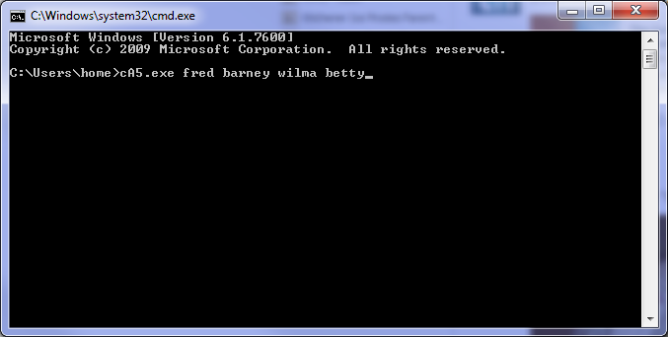

Slide 20
If you need to provide command line arguments while working and testing within the Visual C++ IDE, there is a way to do this.

Slide 21
Under the Project menu, there’s an item called Properties.

Slide 22
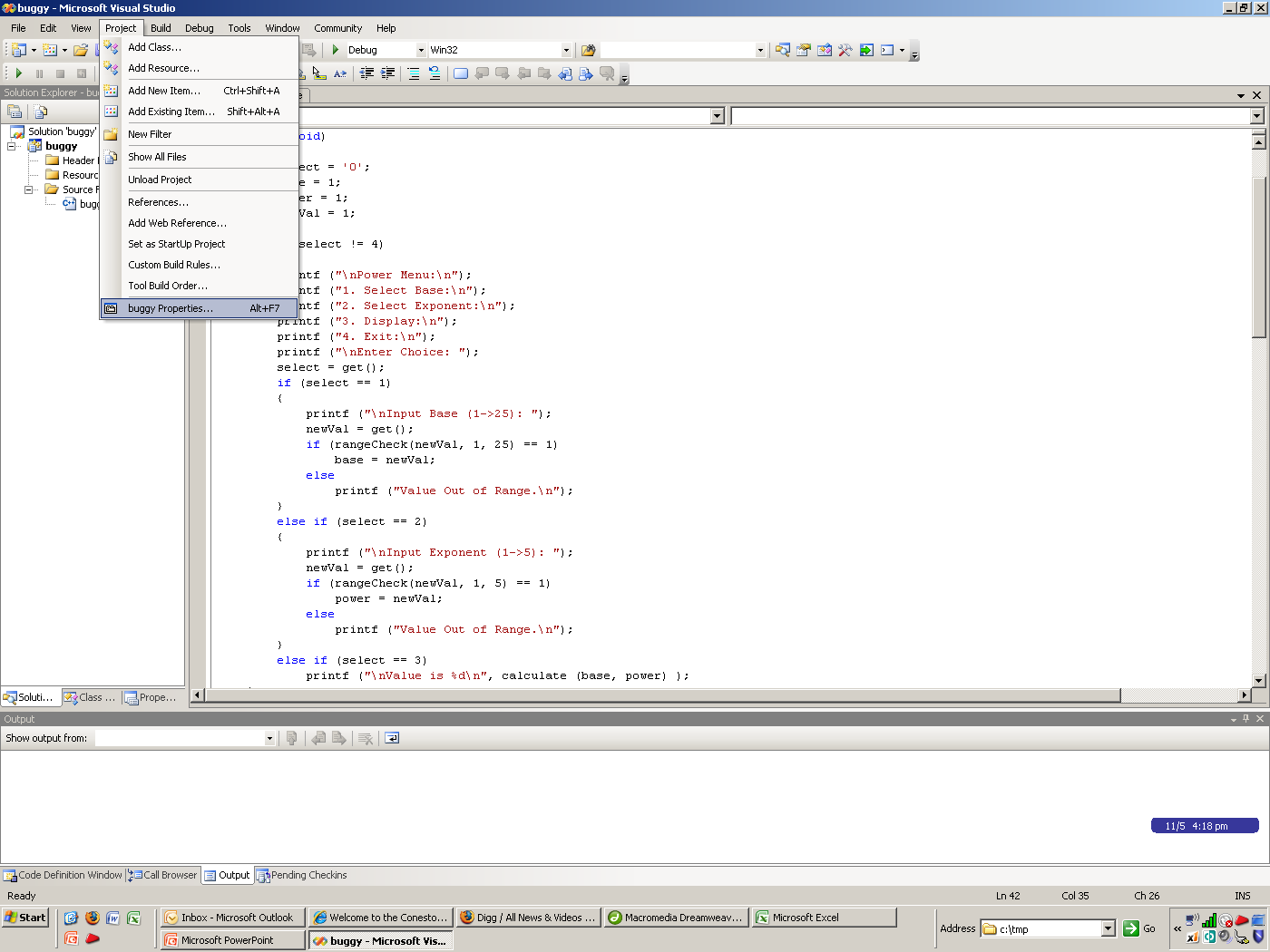

Slide 23
Under the Debugging item, put the command line arguments you want

Slide 24
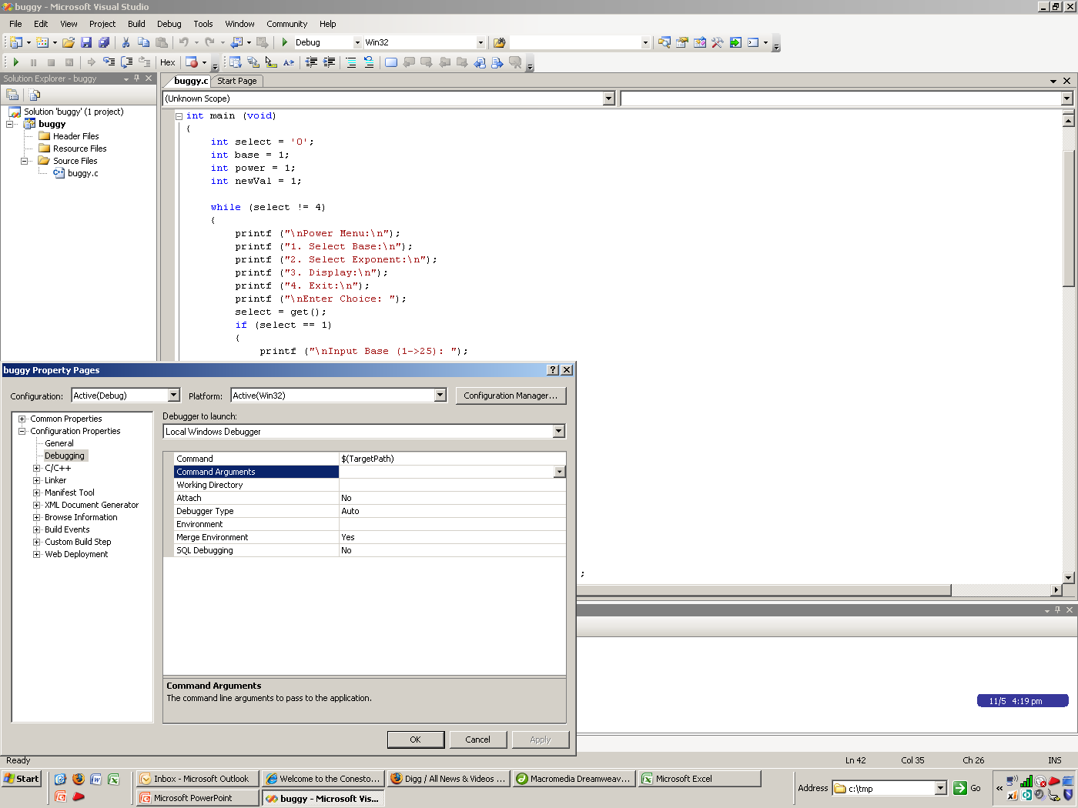

Slide 25
This is sticky
every time
you start up
the project.

Slide 26
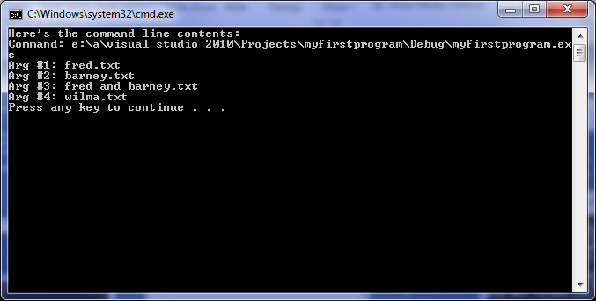

Slide 27
Return values from main()

Slide 28
int main() vs. void main()
Some languages like C# and Java have main() returning no value

Slide 29
The C standard does require that main() return an int value

Slide 30
So far, you’ve been returning 0 from main()

Slide 31
0
means
“no error or anything exceptional occurred”

Slide 32
Returning a non-zero value from main() can indicate an error code or an exceptional success code

Slide 33
This is only of use if the program is run from a command shell and the return value is checked by an external shell command

Slide 34
External Shell Command?
This will be of far greater significance next semester in the System Application Development course

Slide 35
Real-Life Linux Command Examples
diff: file comparison utility
0: no differences
1: differences
2: error

Slide 36
passwd: password changing utility
0: the password was changed
1: means the password was not changed

Slide 37
cd: change directory
0: the directory is successfully changed
non-zero otherwise

Slide 38
Visual C++-ism
Visual C++ 2010 does not require you to return a value from main()

Slide 39
For this course (and other courses, unless otherwise specified), you must return a value from main(), regardless of whether or not the compiler will permit you to omit it

